Slide 1
Resources for CS1 and CS2
https://faculty.knox.edu/dbunde/teaching/ipdps26/

Slide 2
A traditional CS1 course
Teaches how to write programs
  For a single core
  Without graphics
  Without other machines or a network
  Entire programs, starting with a blank file
  On your own
  With limited tools (no build tools, no version control, …)
All using lecture pedagogy

Slide 3
CDER (Curriculum Development and Educational Resources)
Created new versions of the first two courses:
  In Java (at Knox College): https://drive.google.com/drive/folders/1cMzjVculBfxHtpkEJ88GBusfMWfNbBCW?usp=sharing
  In C++ (at Tennessee Tech):
  https://drive.google.com/drive/folders/1zddkyEZt73EB0_StKk1sT2USAzqVHkdu?usp=sharing
Concepts to bring in:
  Data parallelism
  Interaction with server (distributed computing)
  Event handling

Slide 4
Knox College CS-1 course structure
10 week courses, but last week is mostly finals
Three 70-minute class periods, plus one 70 min lab period
CS-1 “lab” is first hour of large weekly coding assignment
  Ensure everyone can install and run assignment
  Identify and fix problems
  Help students get started, build momentum
  Assignment due to LMS before next lab period
Two in-class written midterms, plus written final
  Always give students exam from last term as “practice exam”

Slide 5






Pedagogy: “flipped classroom” Instruction
flipped classroom
“Lecture”
Homework
Textbook/
Online mini-lecture
Exam
Q
U
I
Z
First Exposure:
Learn Hard Stuff:
With teacher and
discussion
Show Knowledge
Mastery
See if You
Know Hard Stuff

Slide 6
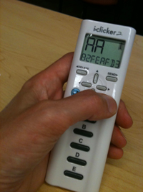
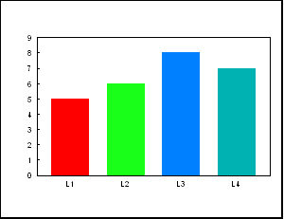
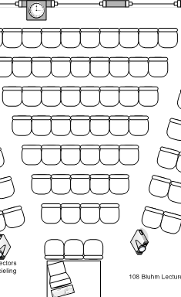
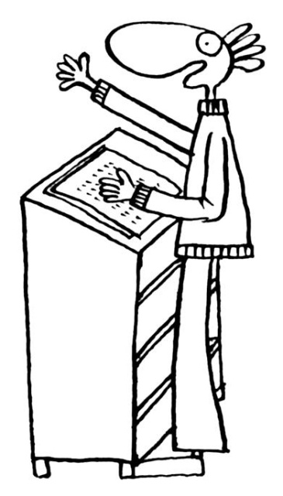
Peer Instruction: Clicker Questions
1
3
2

Slide 7
Weekly schedule
Week | Topics | Weekly Coding Assignment | Notes
1 | variables, types | Install VS Code
2 | conditionals, loops | Java Turtles (Logo) | “AI honeypot”
3 | strings | Flagmaker | Flagmaker, Unplugged Flagmaker
4 | functions | Codingbat #1 (short functions) | custom problems
5 | arrays | Codingbat #2, Testing
6 | 2D arrays, event classes | Event Calendar Minecraft or Tic-tac-toe | JSON, Distributed events
7 | event driven programming, writing classes | Greenfoot (week 1) | Event driven programming
8 | writing classes | Greenfoot (week 2) | Event driven programming
9 | Recursion | Recursion
10 | wrap up, finals

Slide 8
“AI honeypot”
First Java coding assignment in week 2 uses Turtle Graphics, a reimplementation of Logo in Java
If you paste the assignment description into AI, it will generate Swing code, not Turtle Graphics
Can catch people right away, send to honor board, hopefully communicate to students that we care that they do things the right way

Slide 9
Flagmaker

Slide 10
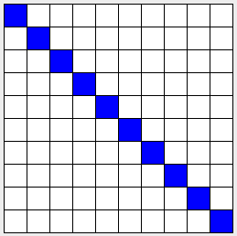
Draw a diagonal line
for (int i=0; i<g.getNumRows(); i++) {
g.setColor(i, i, Color.BLUE);
}
for (int i=0; i<g.getNumRows(); i++) {
g.setColor(0, i, Color.BLUE);
}
for (int i=g.getNumRows()-1; i>=0; i--) {
g.setColor(i, i, Color.BLUE);
}
for (int i=g.getNumRows(); i>0; i--) {
g.setColor(i, i, Color.BLUE);
}
A
B
C
D
E Not exactly one of the above

Slide 11
Draw a diagonal line
Two correct answers!
Plot twist!
Which is better?
for (int i=0; i<g.getNumRows(); i++) {
g.setColor(i, i, Color.BLUE);
}
for (int i=0; i<g.getNumRows(); i++) {
g.setColor(0, i, Color.BLUE);
}
for (int i=g.getNumRows()-1; i>=0; i--) {
g.setColor(i, i, Color.BLUE);
}
for (int i=g.getNumRows(); i>0; i--) {
g.setColor(i, i, Color.BLUE);
}
A
B
C
D
E Not exactly one of the above

Slide 12
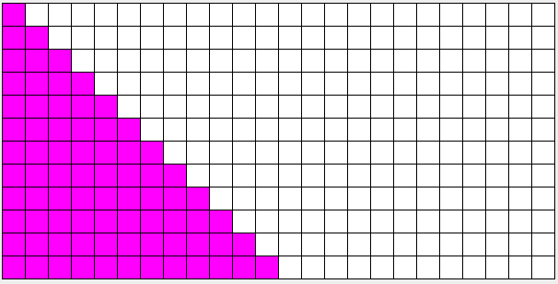
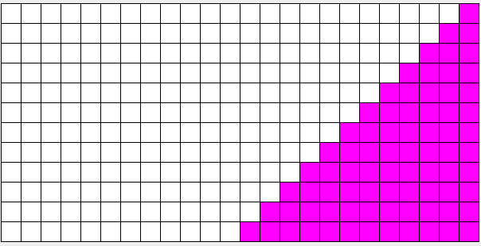
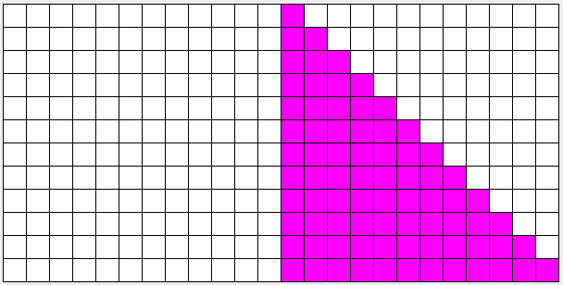
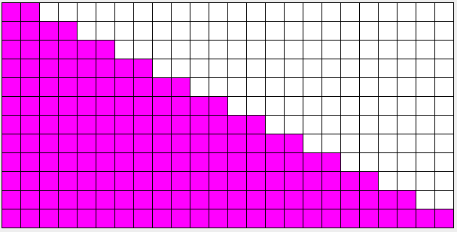
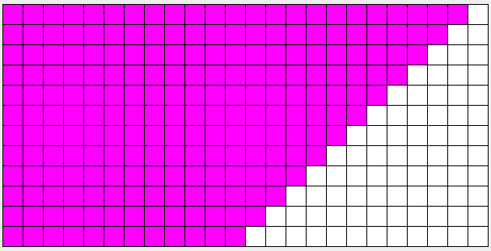
What squares will the code below color?
// assume grid is 10x20
for (int i = 0; i<grid.getNumRows(); i++) { //all the rows
for (int j = 0; j<=(2*i+1); j++) { // from col [0] to col [2*row+1], inclusively
grid.setColor(i, j, Color.MAGENTA);
}
}
A
C
E
B
D

Slide 13
3D turtles in Minecraft
(Jurdana Masuma Iqrah, Jaime Spacco, Michael Gerten, EduPar 2026)
Students write code (Java, Python, et al.) to control a “turtle” in Minecraft
Drawing happens in a modded Minecraft server, which students can view in unmodified client
Can create multiple turtles to draw in parallel
Come see more tomorrow (5/26) at 2:30pm session of EduPar in Salon D

Slide 14
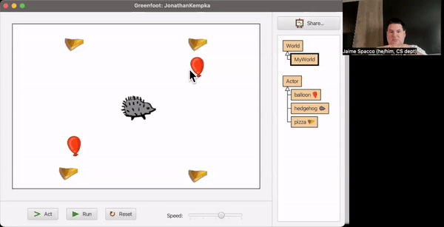
Greenfoot
Free educational Java IDE: www.greenfoot.org
Add sprites and code for them
Really a simple game engine for novice Java programmers
Simple game found online:
Hedgehog needs to eat
Cheese and dodge balloons

Slide 15
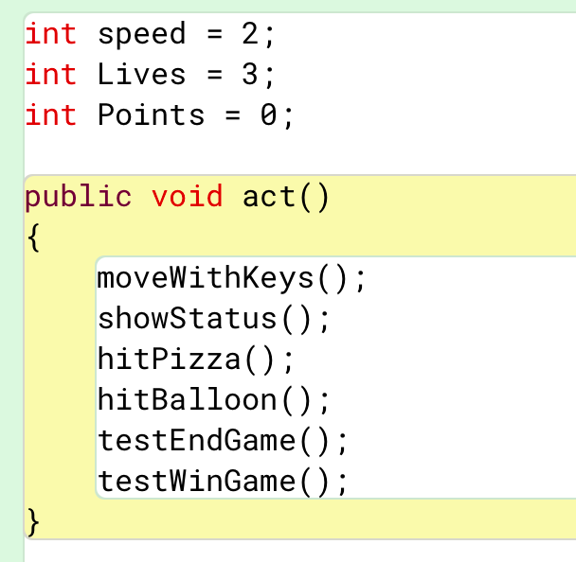
Hedgehog state
Act() method called each frame (e.g. 30 fps)

Slide 16
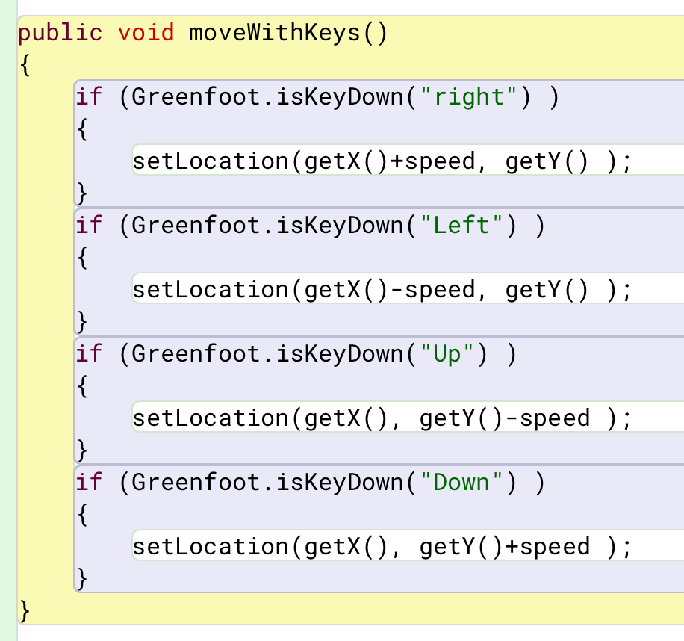
Code to move Hedgehog

Slide 17
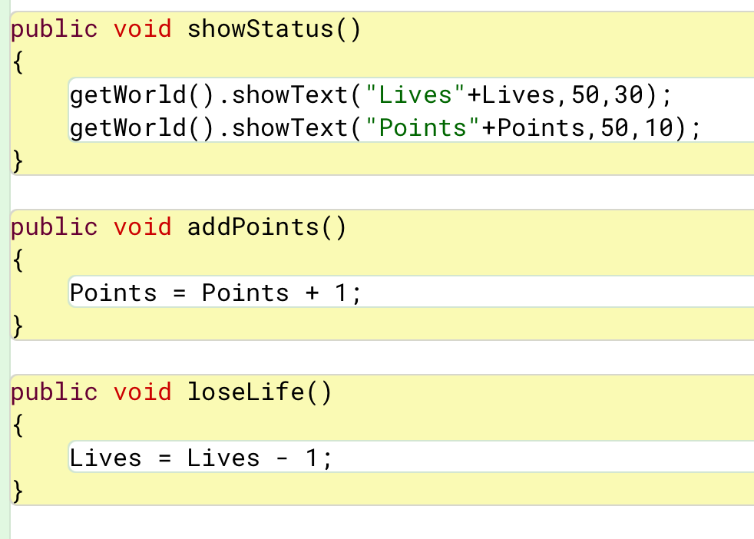
Status updates and display

Slide 18
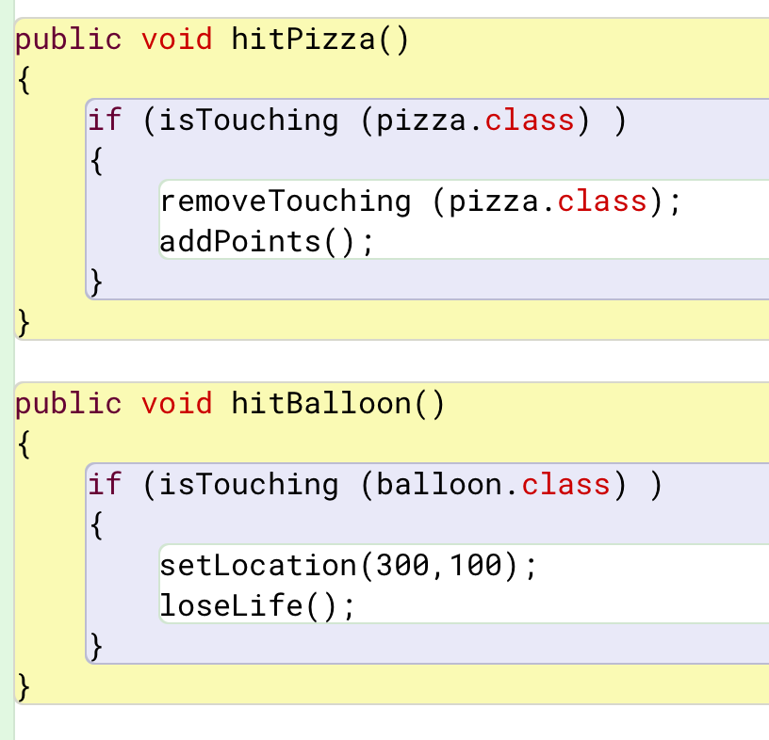
Collisions with pizza and balloons

Slide 19
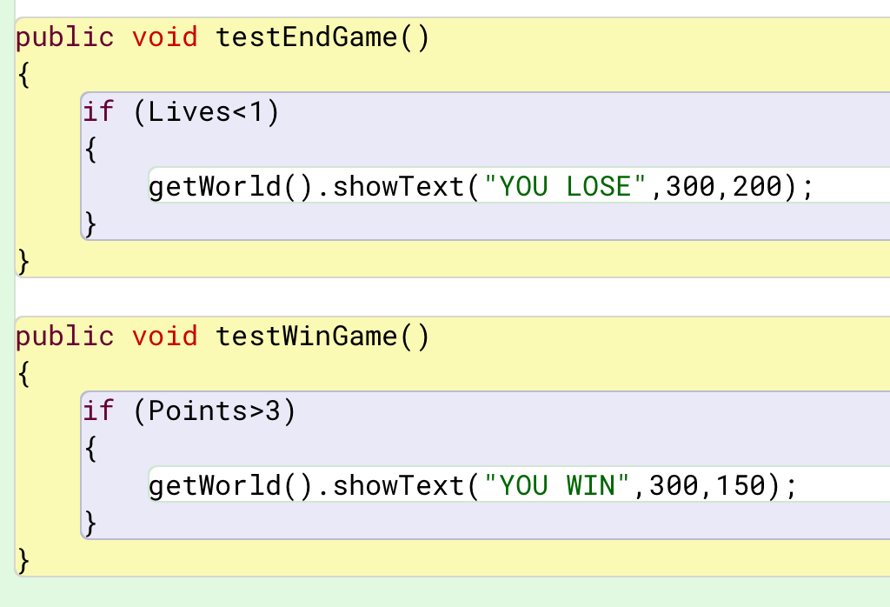
Win and lose conditions

Slide 20
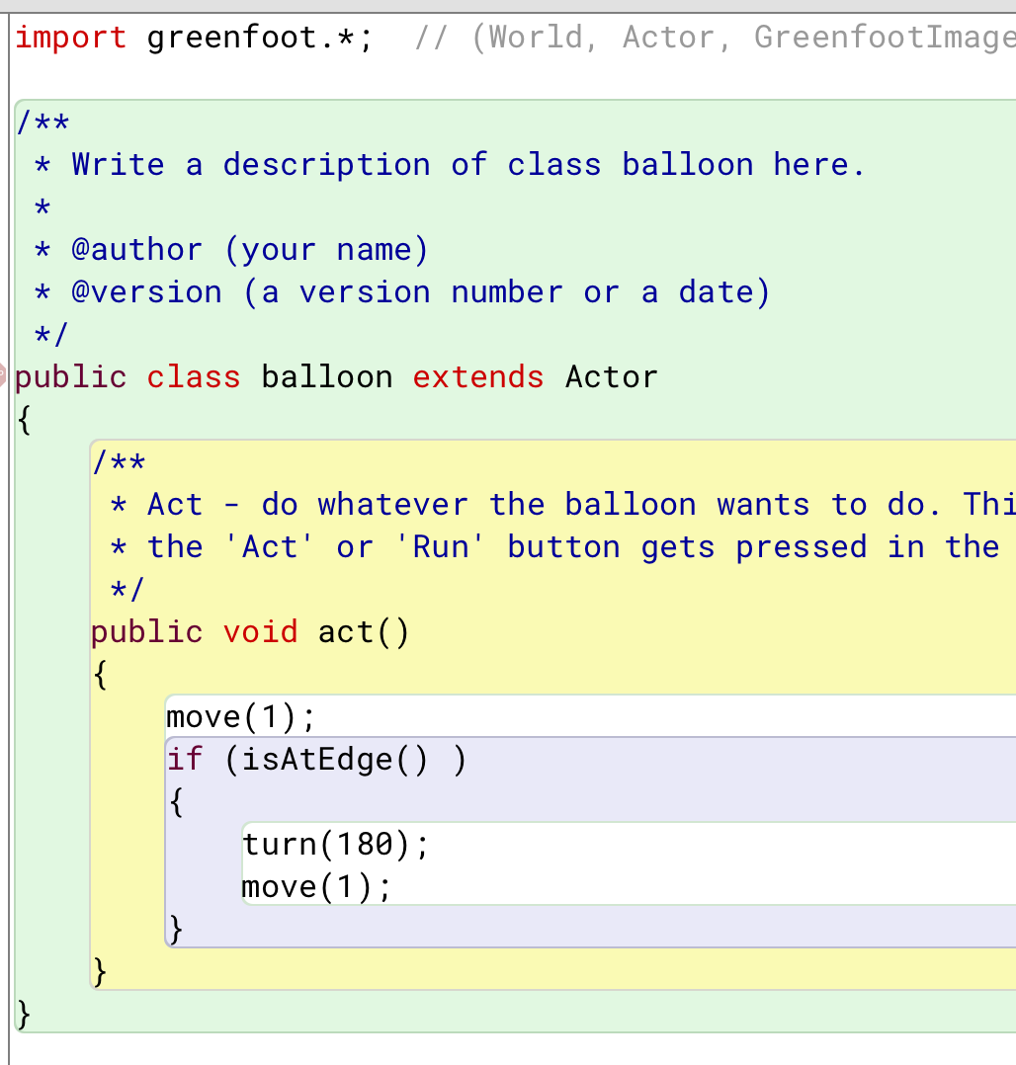
Entire balloon code

Slide 21
Use in CS1
Open-ended assignment: Make a game! (w/ >=X sprites and >=Y functions)
  Tradeoff between students who get excited and students who do the minimum
Advantages
  Students love it
  Easy to install
  Compact API with useful functionality (like collision detection)
Disadvantages
  Default graphics looks middle school, but easy to add
  Different IDE from whatever you use
  “Complex” things require scaffolding: animation, moving between screens
  Lots of online samples and tutorials that students can mindlessly follow
  (probably disallow snake game, flappy bird, …)

Slide 22
Changes to CS2
Less writing code for list/stack/queue (still clicker questions)
More emphasis on iterators (modifying and not just reading)
Design problems
Parallelism using fork/join (following Dan Grossman, UWash)

Slide 23
Sample design problem
You’re cleaning your dorm room, but every time you start one job you find another that needs your attention first! You try to put away your laundry, but it’s all dirty! Then when you try to wash your laundry you find that your laundry basket is filled with junk you’ve been too lazy to put away, and when you try to put some stuff away you find some nasty old moldy food that you have to clean up, etc. Note that each time you discover a new task, it must be completed before the one that you were previously working on. What ADT would you use to help you keep track of all the subtasks you have to do before your room is finally clean?
(A. List B. Stack C. Queue D. Map or Set E. None of the above)

Slide 24
Labs
1 (day 1): Implementing Array-based Bag
2: Testing PrintQueue
3: Implementing linked lists
4: Timing data structures
5: Exploring a cave (backtracking w/ stacks)
6: Implementing lists w/ recursion
7: Navigation system (comparators and iterators)
8: Building friendship graph
9: Parallelizing heat diffusion
Notes:
“Traditional” course was W23

Slide 25
Labs
1 (day 1): Implementing Array-based Bag
2: Testing PrintQueue
3: Implementing linked lists
4: Timing data structures
5: Exploring a cave (backtracking w/ stacks)
6: Implementing lists w/ recursion
7: Navigation system (comparators and iterators)
8: Building friendship graph
9: Parallelizing heat diffusion
3: Finding common queries (iterators)
8: Prime counting with fork-join
9: Reductions with fork-join
7
6

Slide 26
Fork-join
int sum(int[] array, int low, int hi) {
if(hi==low+1)
return array[low];
int left = fork sum(array, low, (hi+low)/2);
int right = sum(array, (hi+low)/2, hi);
join;
return left + right;
}
int result = sum(…);

Slide 27
Fork-join
int sum(int[] array, int low, int hi) {
if(hi==low+1)
return array[low];
int left = fork sum(array, low, (hi+low)/2);
int right = sum(array, (hi+low)/2, hi);
join;
return left + right;
}
int result = sum(…);
class Sum extends RecursiveTask<Integer> {
//attributes and constructor
protected Integer compute(){
if(hi – low < THRESHOLD) …
Sum left = new Sum(array, low, (hi+low)/2);
Sum right = new Sum(array, (hi+low)/2, hi);
left.fork();
return right.compute() + left.join();
}
}
sum = ForkJoinPool.commonPool().invoke(
new Sum(array, 0, array.length));

Slide 28
Beyond the code
Precedence diagrams
  Drawing based on code, running them
Work and span metrics
Without terminology: non-determinism, load balance, speedup
a
b
c
d
e
f

