Slide 1
“Unplugged” Flagmaker Activity

Slide 2

Activity idea
You’ll be pretending to be the computer drawing the flag of Mauritius:
You’ll use paper and markers, but otherwise follow
how a computer might draw it:
Color one cell at at a time
Fill in the squares thoroughly (but quickly)
Img from: https://en.wikipedia.org/wiki/Mauritius

Slide 3

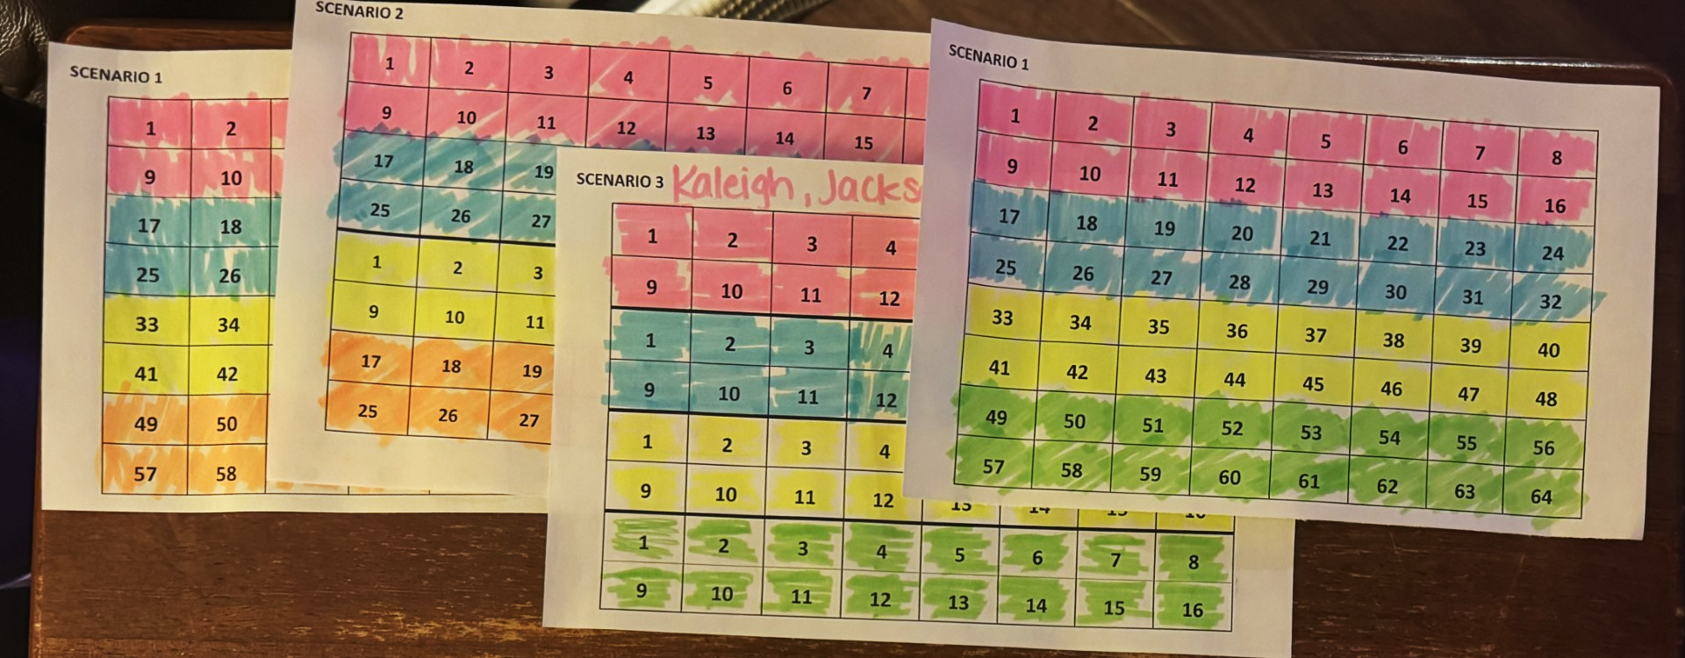

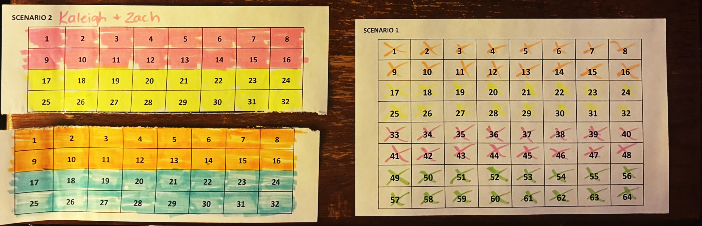
How to color
CORRECT!
You must color one square at a time.
Do not color in multiple squares at one time.
WRONG!
Fill in the squares
WRONG!
Don’t tear the paper!

Slide 4
Scenario 1: Single processor
Two people:
The Processor: colors first stripe (cell by cell), second stripe (cell by cell), third stripe (cell by cell), and then fourth stripe (cell by cell)
Timer: Times the Processor
P1

Slide 5
Scenario 2: Two processors collaborating
Now 2 processors each help draw
Three people:
Processor 1: Colors red and blue stripes (cell by cell)
Processor 2: Colors yellow and green stripes (cell by cell)
Timer: Times them; stop when all cells are colored
P1 | 1 | 2 | 3 | 4 | 5 | 6 | 7 | 8
 | 9 | 10 | 11 | 12 | 13 | 14 | 15 | 16
 | 17 | 18 | 19 | 20 | 21 | 22 | 23 | 24
 | 25 | 26 | 27 | 28 | 29 | 30 | 31 | 32
P2 | 1 | 2 | 3 | 4 | 5 | 6 | 7 | 8
 | 9 | 10 | 11 | 12 | 13 | 14 | 15 | 16
 | 17 | 18 | 19 | 20 | 21 | 22 | 23 | 24
 | 25 | 26 | 27 | 28 | 29 | 30 | 31 | 32

Slide 6
Scenario 3: Four processors collaborating
Five people:
1-4. Processors: Each assigned
to one color, which they color
(cell by cell)
5. Timer: Again, stop when all
cells are colored
P1 | 1 | 2 | 3 | 4 | 5 | 6 | 7 | 8
 | 9 | 10 | 11 | 12 | 13 | 14 | 15 | 16
P2 | 1 | 2 | 3 | 4 | 5 | 6 | 7 | 8
 | 9 | 10 | 11 | 12 | 13 | 14 | 15 | 16
P3 | 1 | 2 | 3 | 4 | 5 | 6 | 7 | 8
 | 9 | 10 | 11 | 12 | 13 | 14 | 15 | 16
P4 | 1 | 2 | 3 | 4 | 5 | 6 | 7 | 8
 | 9 | 10 | 11 | 12 | 13 | 14 | 15 | 16

Slide 7
Scenario 4: Four processors collaborating a different way
1-4. Processors: Each assigned
a strip of two columns (first
takes left 2 columns, second
takes next two columns, etc).
Colors these cell by cell
5. Timer: Same as before
P1 |  | P2 |  | P3 |  | P4
1 | 9 | 1 | 9 | 1 | 9 | 1 | 9
2 | 10 | 2 | 10 | 2 | 10 | 2 | 10
3 | 11 | 3 | 11 | 3 | 11 | 3 | 11
4 | 12 | 4 | 12 | 4 | 12 | 4 | 12
5 | 13 | 5 | 13 | 5 | 13 | 5 | 13
6 | 14 | 6 | 14 | 6 | 14 | 6 | 14
7 | 15 | 7 | 15 | 7 | 15 | 7 | 15
8 | 16 | 8 | 16 | 8 | 16 | 8 | 16

Slide 8
Post-activity discussion

Slide 9
Post-activity discussion
Speedup
Warm up
Technology differences
Contention
Pipelining

Slide 10
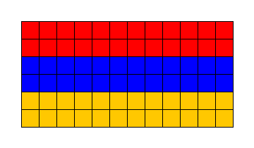
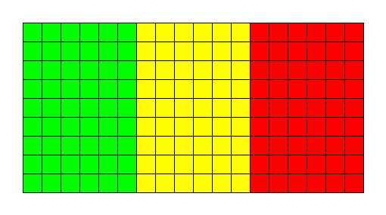
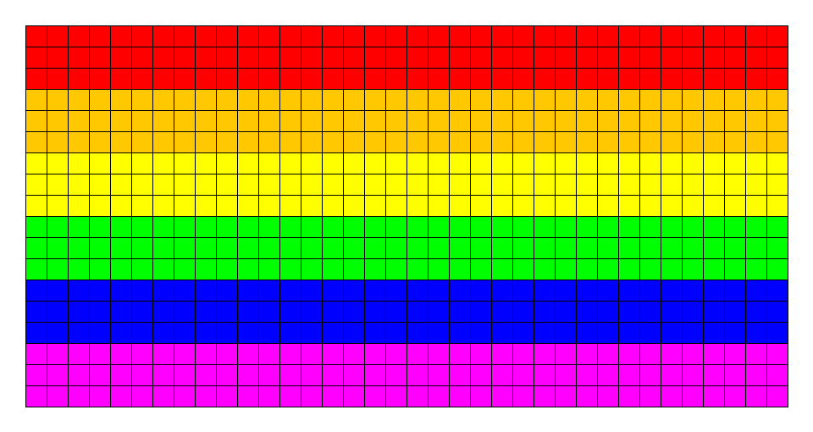
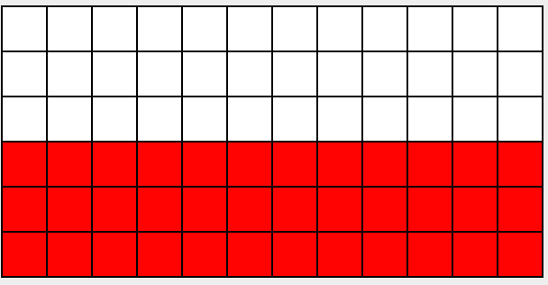
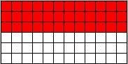
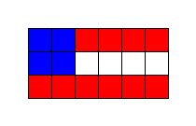
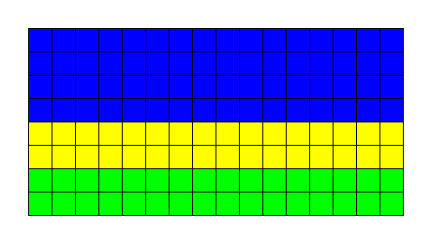
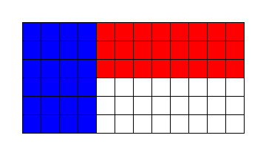
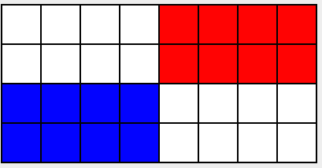
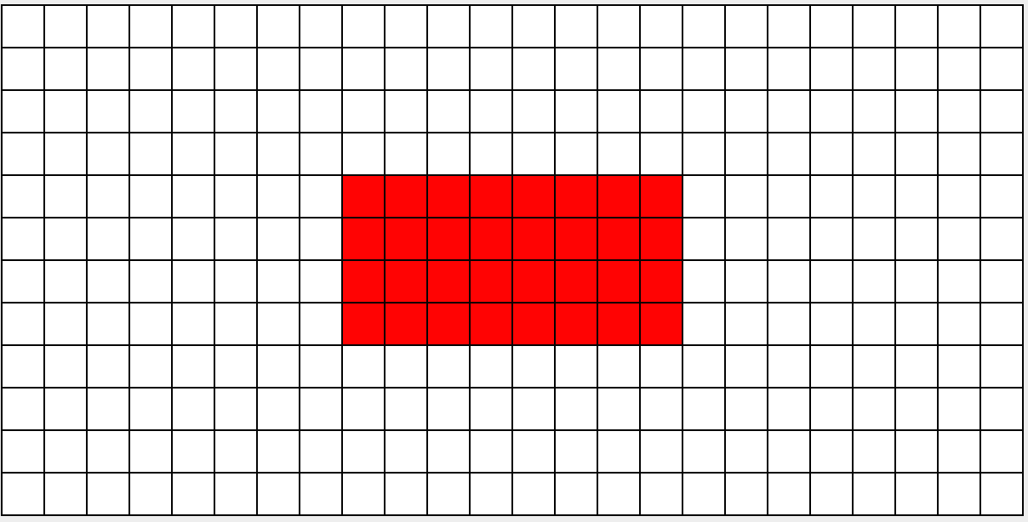
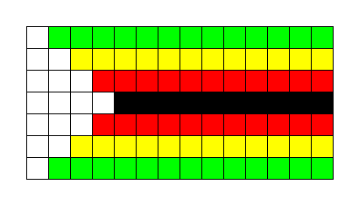
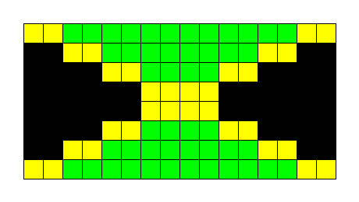
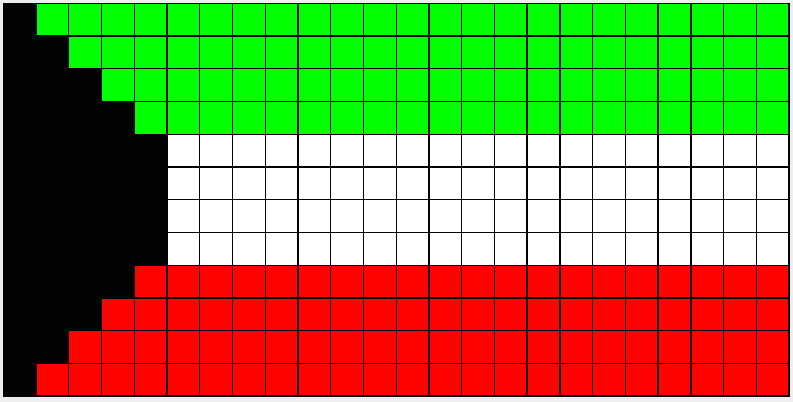
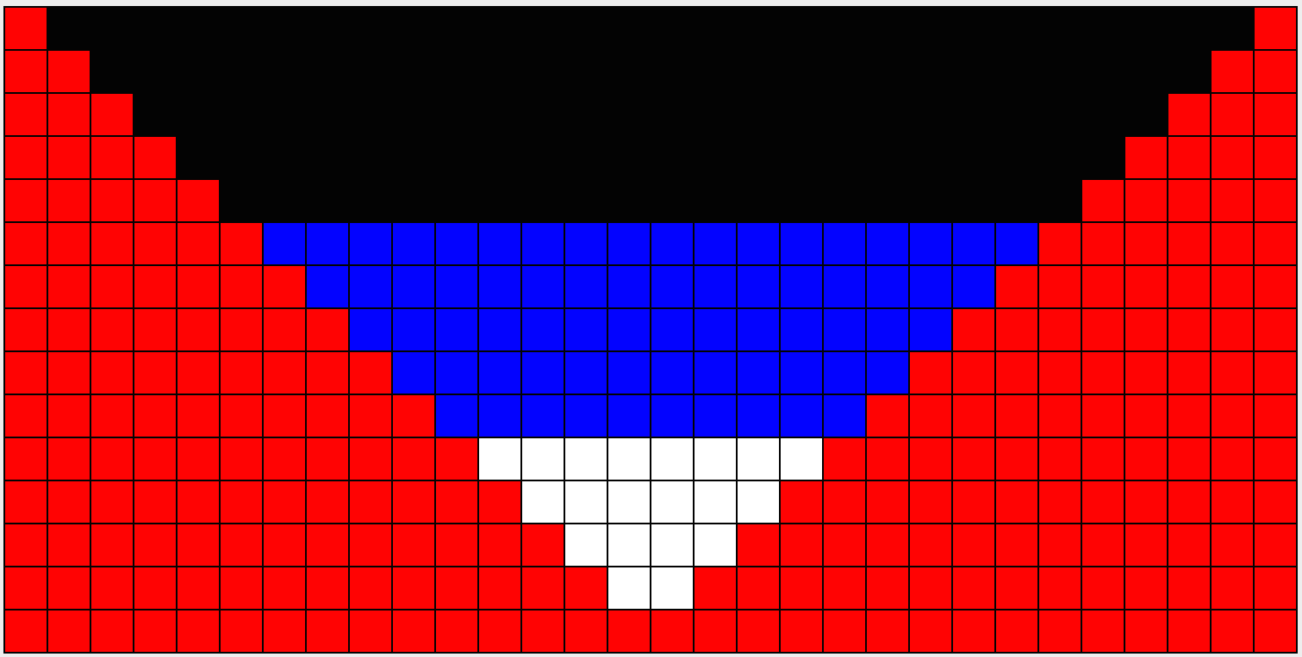
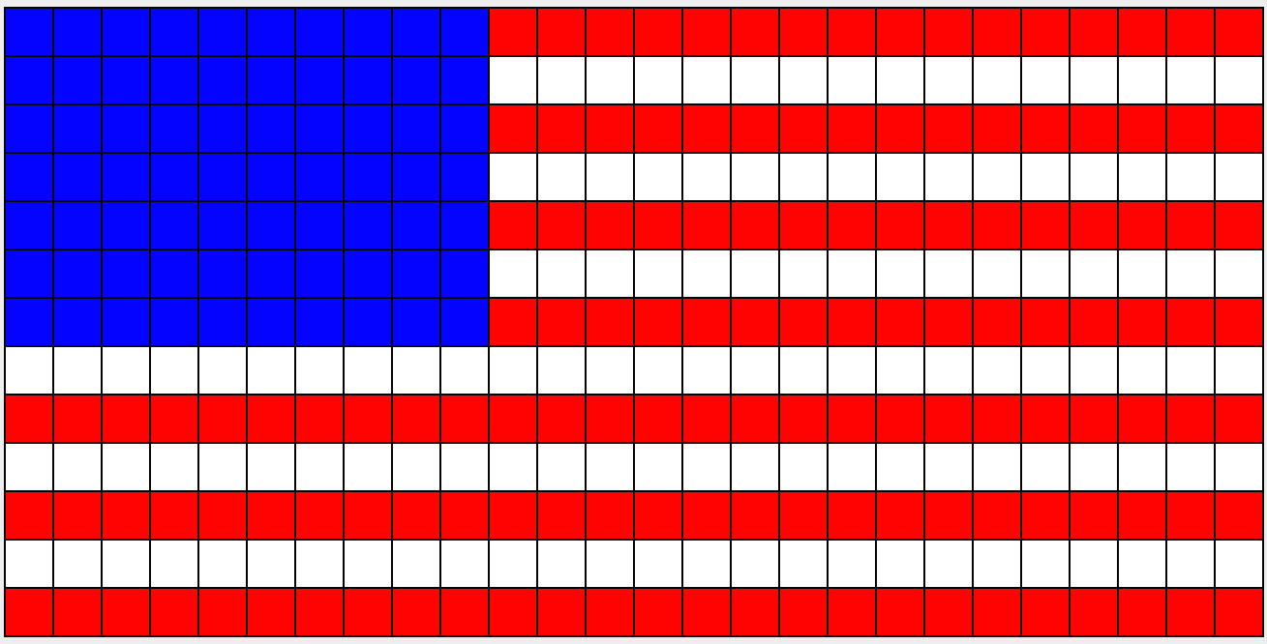
Programming activity: Teach loops with flag drawing!
Java application with methods they fill in to draw each flag
Has support for debugging, grading, and changing the flags

Slide 11
What is the first cell that this code colors?
int rows = g.getNumRows();
int cols = g.getNumCols();
for(int i=0; i<rows; i++) {
for(int j=0; j<cols; j++) {
g.setColor(i, j, Color.RED);
}
}
A
B
C
D
E: None of the above

Slide 12
What is the first cell that this code colors?
int rows = g.getNumRows();
int cols = g.getNumCols();
for(int i=0; i<rows; i++) {
for(int j=0; j<cols; j++) {
g.setColor(i, j, Color.RED);
}
}
A
B
C
D
E: None of the above

Slide 13
What is the second cell that this code colors?
int rows = g.getNumRows();
int cols = g.getNumCols();
for(int i=0; i<rows; i++) {
for(int j=0; j<cols; j++) {
g.setColor(i, j, Color.RED);
}
}
A
B
C
D
E: None of the above

Slide 14
What is the second cell that this code colors?
int rows = g.getNumRows();
int cols = g.getNumCols();
for(int i=0; i<rows; i++) {
for(int j=0; j<cols; j++) {
g.setColor(i, j, Color.RED);
}
}
A
B
C
D
E: None of the above

Slide 15

How would you draw the British flag?
https://en.wikipedia.org/wiki/Flag_of_Great_Britain#/media/File:Flag_of_Great_Britain_(1707%E2%80%931800).svg

Slide 16
One strategy: Drawing “layers”
Color entire background blue
Draw white diagonals
Draw vertical and horizontal red lines

Slide 17
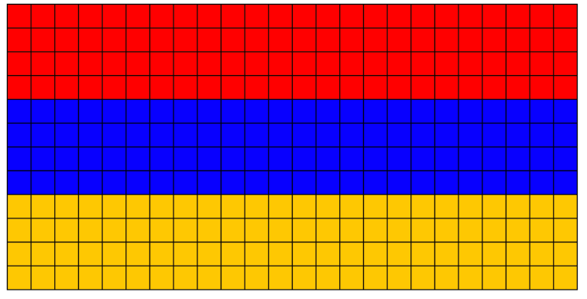
Parallel computation
(concept only now, do in later courses)
Modern computers are all multicore (dual-core, quad-core, …) so they can perform multiple operations at a time
Potentially speeds up some tasks, like drawing the Armenian flag
  Simultaneously do these tasks:
  Draw red stripe
  Draw blue stripe
  Draw yellow stripe

Slide 18
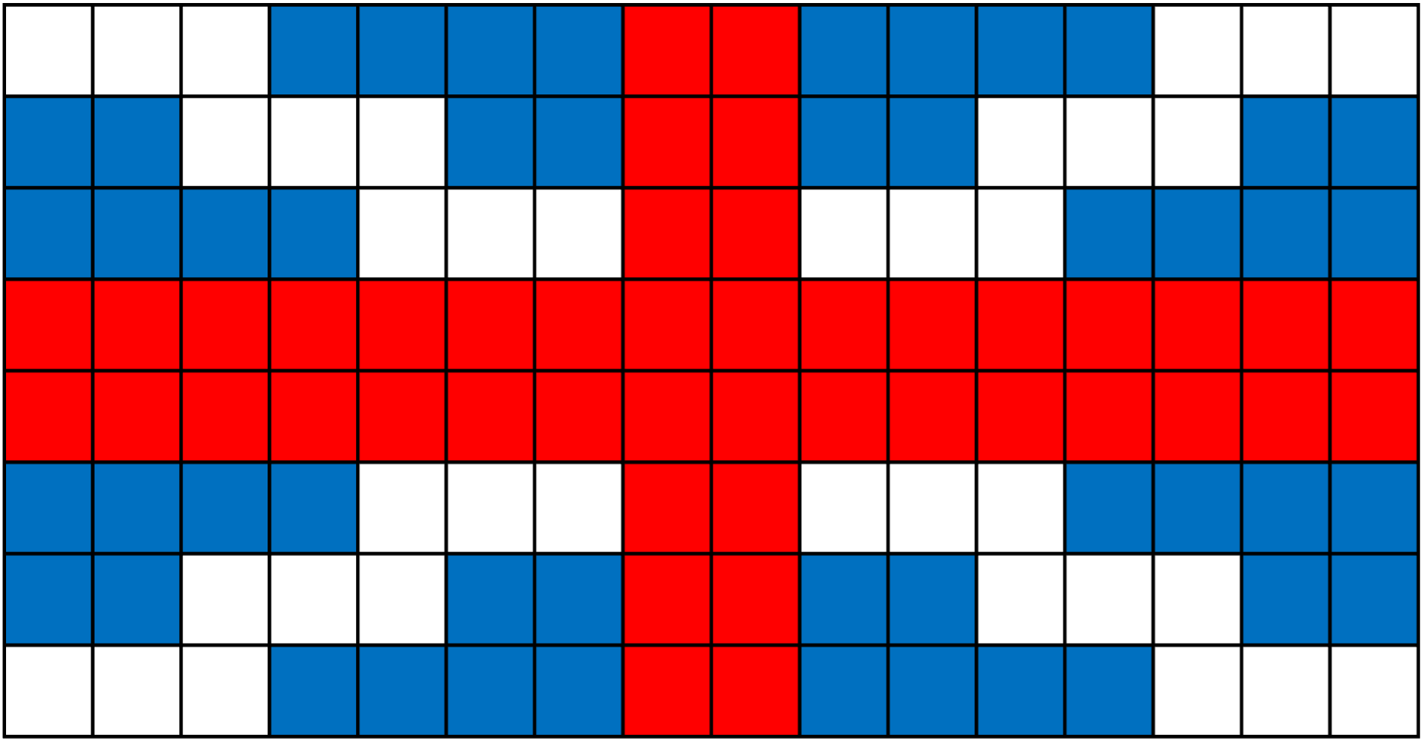
Parallel computation
(concept only now, do in later courses)
Modern computers are all multicore (dual-core, quad-core, …) so they can perform multiple operations at a time
Potentially speeds up some tasks, like drawing the Armenian flag
  Simultaneously do these tasks:
  Draw red stripe
  Draw blue stripe
  Draw yellow stripe
Can we do this with the British flag?

Slide 19
“Task Graph”
Diagram of dependencies (when one thing must come before another)
  For flags: when operations would color a tile different colors
  Draw arrows to show which must come before others
Draw white
\ stripe
Draw red vertical stripe
Draw blue stripe
Draw red stripe
Draw blue background
Draw white
/ stripe
Draw red horizontal stripe
Draw yellow stripe

Slide 20

Create a task graph to draw the flag of Jordan
https://upload.wikimedia.org/wikipedia/commons/c/c0/Flag_of_Jordan.svg

