Slide 1
Peachy Assignments: Cool, Adoptable Parallel and Distributed Computing Assignments
https://tcpp.cs.gsu.edu/curriculum/?q=peachy

Slide 2
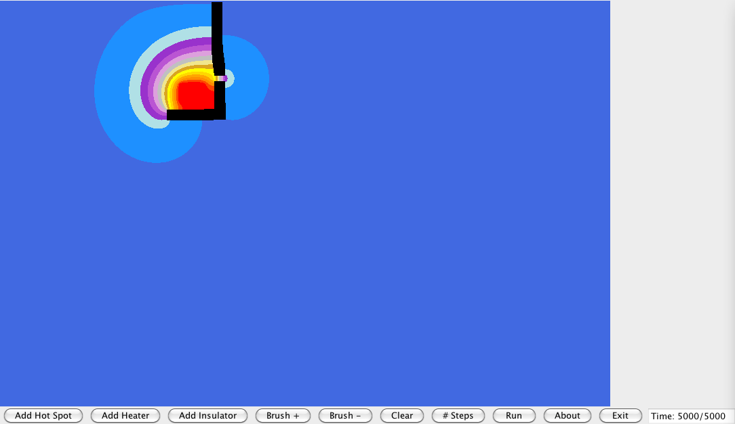
Peachy Assignments: Motivation
Good course assignments
Inspire students
Improve student learning
Are fun to give
Are lots of work to create
Don’t always work as well as we thought
Successful assignments should be shared like
"Nifty Assignments" (http://nifty.stanford.edu)

Slide 3
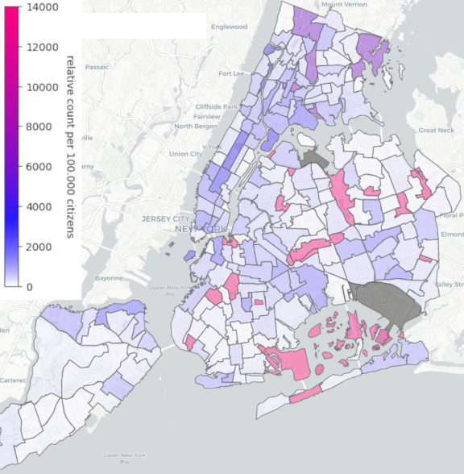
Peachy Assignments
Selected competitively and presented at
  EduPar (co-located with IPDPS in May)
  EduHPC (co-located with SC in November)
Available on the Peachy website
https://tcpp.cs.gsu.edu/curriculum/?q=peachy
(or Google Peachy assignment)

Slide 4
Peachy Assignment Criteria
Tested
  Used in the classroom and comes with instructor reflections
Adoptable
  Includes handout and given code for students, plus optional solution
  Description discusses prerequisites and options for adaptation
  Widely-taught concepts using readily available hardware
Cool and inspirational
  Fun and exciting for students
  Ideally, something they show their roommates

Slide 5
Sample Peachy Assignment: 3D turtles in Minecraft
(Jurdana Masuma Iqrah, Jaime Spacco, Michael Gerten, EduPar 2026)
Students write code (Java, Python, et al.) to control a “turtle” in Minecraft
Drawing happens in a modded Minecraft server, which students can view in unmodified client
Can create multiple turtles to draw in parallel

Slide 6
Sample Peachy Assignment: Fairy Rings
(Elizabeth Shoop, EduHPC 2025)
2D discrete event simulation of fairy ring growth
Similar feel to “Game of Life”, but more states and probabilistic

Slide 7
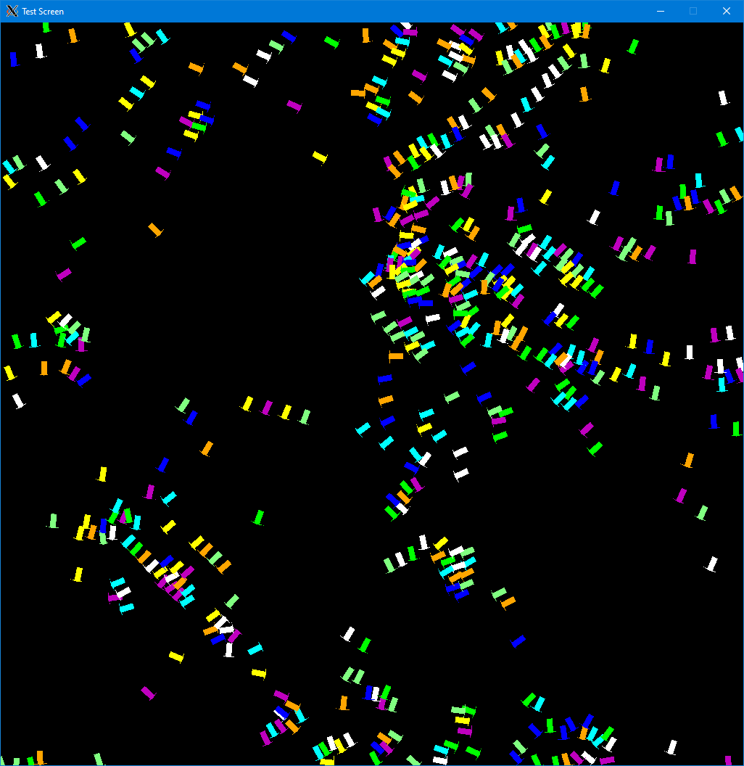
Sample Peachy Assignment: Visualizing parallelism with a flocking algorithm
(Elizabeth Shoop and Ethan Scheelk, EduPar 2024)
“boids” flocking model by Reynolds and Flake
  Each has random initial position and velocity
  Updated each time step based on behavior of the others
Students are given serial code and need to analyze where to apply parallelism using OpenMP
  Result is visibly faster

Slide 8
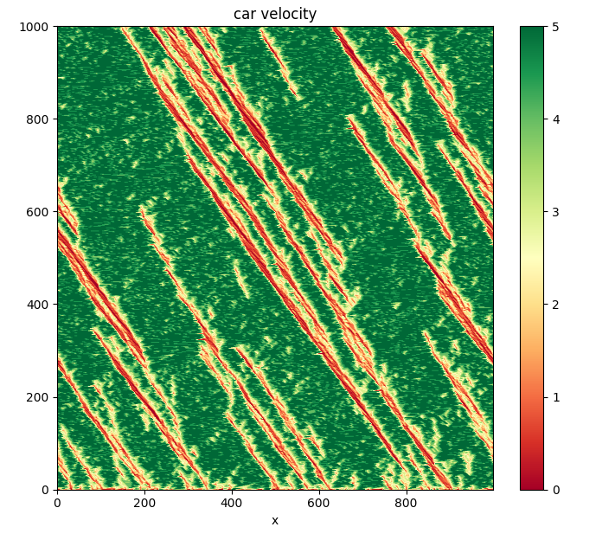
Sample Peachy Assignment: Traffic Jam Modeling
(Ramses von Zon and Marcelo Ponce, EduHPC23)
Nagel-Schreckenberg traffic model
  Chain of cars in one lane, each following simple update rules for their speed
Focus on parallel pseudorandom number generation
Parallelize C++ using OpenMP (MPI or CUDA are suggested variants)

Slide 9
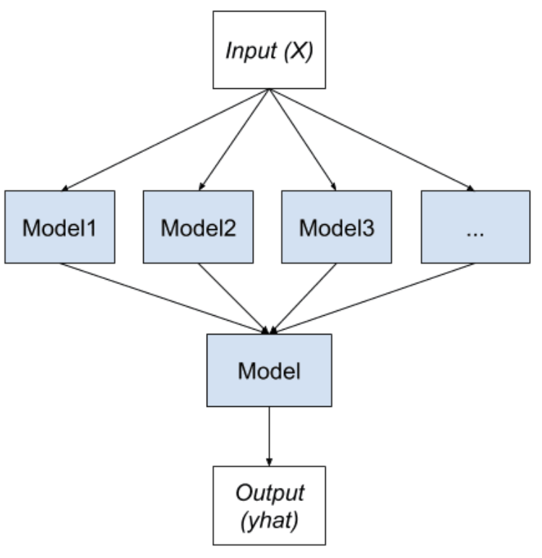
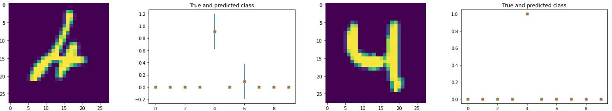
Sample Peachy Assignment: Uncertainty Estimation for Deep Learning
(Pautsch, Li, Rizzi, Thiruvathukal, and Pantoja; EduHPC 23)
Using ensemble of neural networks to estimate confidence in output
Train models independently in parallel using Python

Slide 10

Sample Peachy Assignment: Colliding Spheres
(Iliopoulos, Leiserson, Park, Rosa, and Schadl; EduHPC 22)
N-body simulation with gravity and elastic collisions
Parallelize given C++ using Cilk++
(OpenMP is suggested variant)
Contest to complete as many test inputs as possible in given time

